Slide 1
Facial Emotion Recognition using Machine Learning
Presented by:
Pawan Agrahari (230)

Slide 2
Introduction:
GUI Application
Real Time System
System intends to captures the user's facial emotion
Based on the emotion detected by the system, playlist of songs are recommended

Slide 3
Problem Statement
Difficulty in finding music that appeals to user emotions.
User finds it challenging for manual creation and alteration of music playlist
Current music recommendation system recommends songs based on user search history pattern which many times doesn't match user current facial emotion.

Slide 4
Purpose of Project
Automatic segregating the list of songs and generating a relevant playlist based on an individual facial emotion.

Slide 5
Objectives
Specific objectives:
1) To develop a system that provides music playlist recommendation based on user facial emotions.
General objectives:
1) To develop a GUI application for music player.
2)To develop a system for real time facial emotion detection.

Slide 6
Academic objectives:
1) To apply theoretical engineering knowledge into practical industrial approach.
2)To use proper object-oriented approach for project building.
3) To learn and implement machine learning, data mining technology.

Slide 7
Literature Review
Anagha S. Dhavalikar and Dr. R. K. Kulkarni Proposed an Automatic Facial Expression recognition system.
Yong-Hwan Lee, Woori Han, and Young Kim proposed a system based on Bezier curve fitting.
A. Lehtiniemi and J. Holm suggested a system for music recommendation based on an animated mood picture.
Yusuf Yaslan proposed an emotion-based music recommendation system that learns the user's emotion from signals obtained through wearable computing devices that are integrated with galvanic skin response (GSR) and photoplethysmography (PPG) physiological sensors in their paper.

Slide 8
Contd…
Ayush Guidel stated that human beings' state of mind and current emotional mood can be easily observed through their facial expressions.
CH Radhika advised manual segregation of a playlist and annotation of songs, following the current emotional state of a user, as a labour-intensive and time-consuming task.
A. Madhuri, m. Deepali, S. Upasana and G. Megha proposed Music Recommendation Based on Face Emotion Recognition where they have used FER-2013 dataset and CNN for emotion detection.

Slide 9
Methodology
Language and tools used:
Core Programming Language: Python 3.0 along with its libraries
Image Processing: OpenCV
Processing of multi-dimensional array: Numpy
Machine Learning Algorithms: SVM, Logistic Regression and Random Forest

Slide 10
Datasets Used
We used three different datasets. They are:
CK+48 dataset (1127 images, 48 x 48 pixels)
FER-2013 (Approx. 28,000 images for training, 3500 images for testing)
Self-created dataset (4336 images)

Slide 11
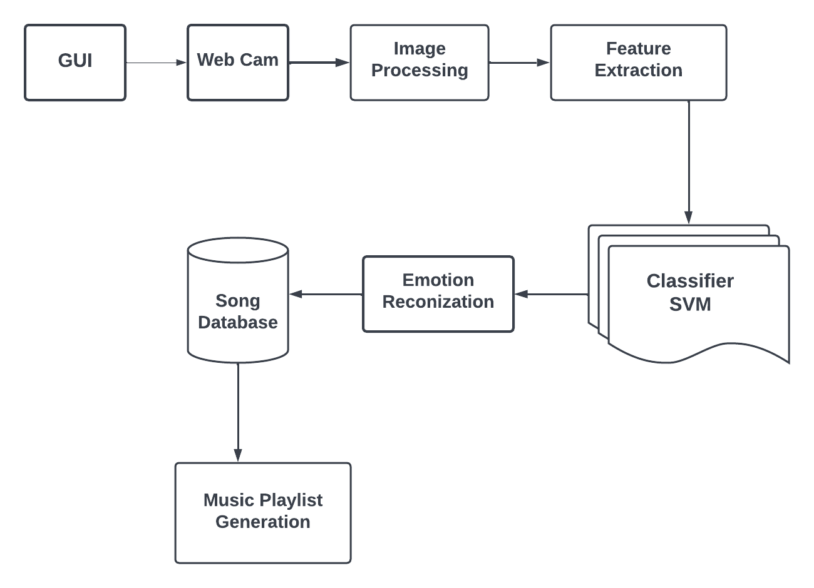
Proposed System

Slide 12
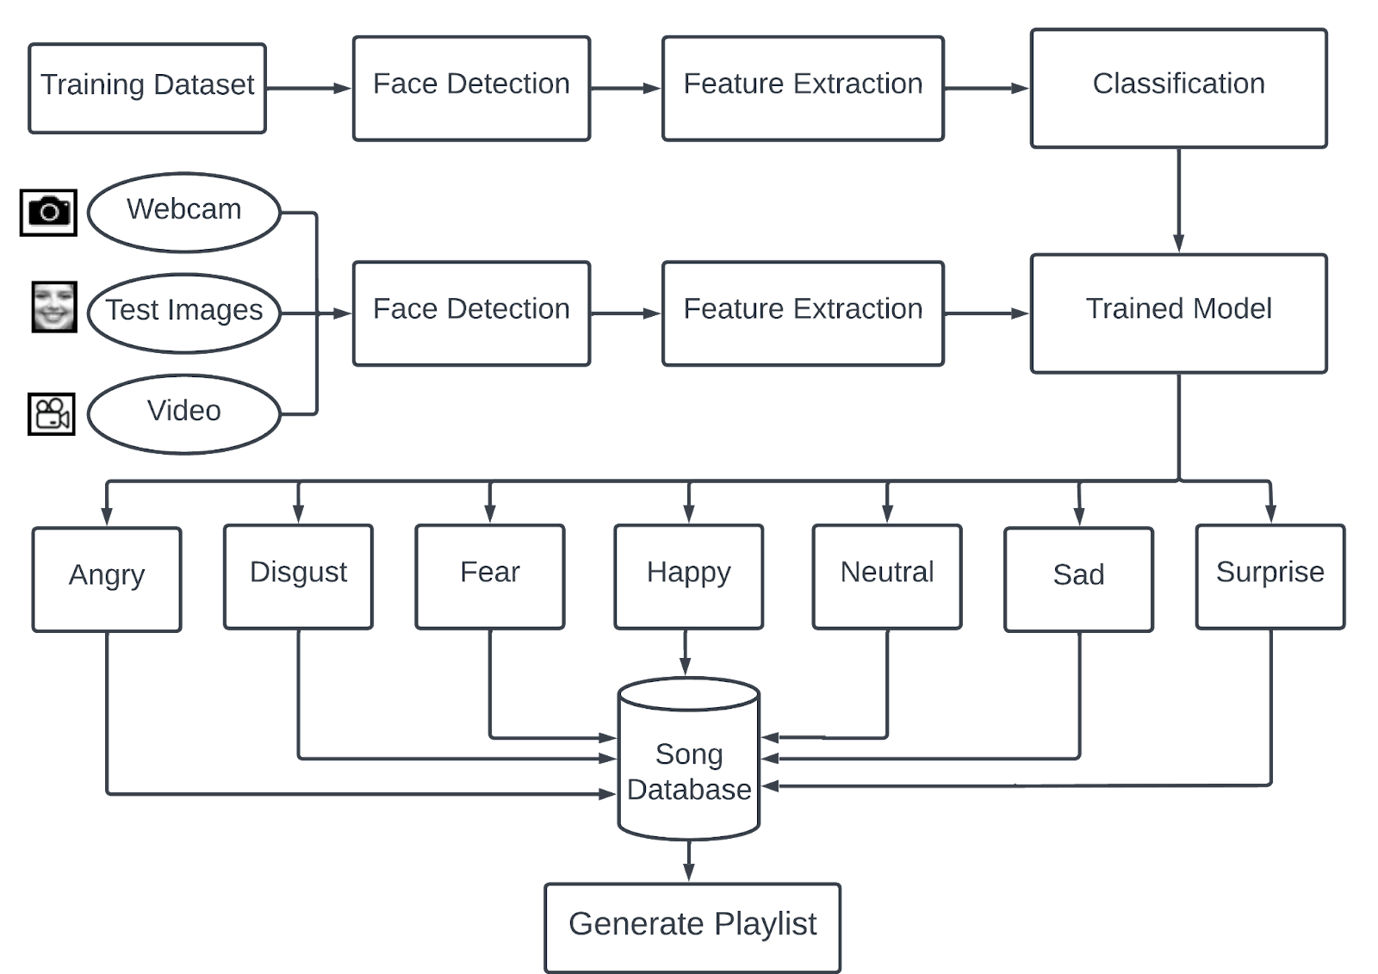
System Diagram

Slide 13
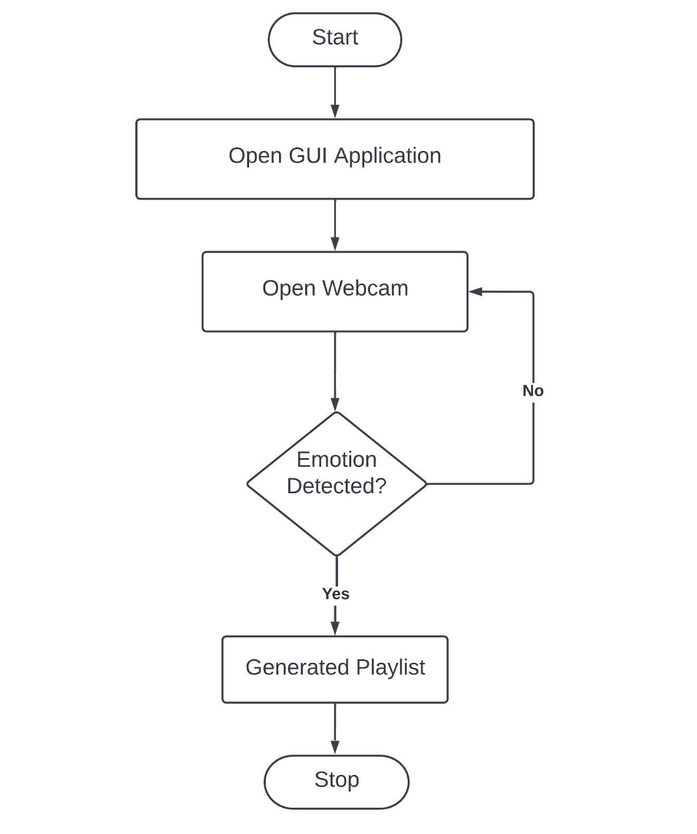
User Diagram

Slide 14
Modules Used
We have used two modules in our proposed system:
1) Emotion Detection Module
Image Capturing
Face Detection
Image Pre-processing
Feature Extraction (LPB and Grayscale pixel value)
Emotion Classification (SVM, Logistic Regression, Random Forest)

Slide 15
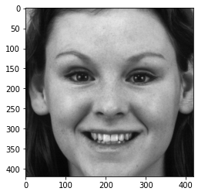
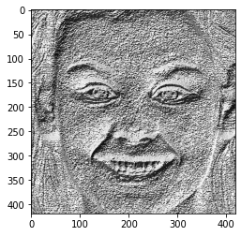
Feature Extracted Images
Gray scale LBP image

Slide 16
Modules Used
2) Music Recommendation Module
Song Database
Music playlist recommendation

Slide 17
Hyperparameter Tuning
Logistic Regression:
C = 1.0 (default)
Solver = liblinear (default)
SVM:
C = 1.0 (default)
Kernel = rbf (default)
gamma = scale (default)
probability = false (default)
Random Forest:
n_estimators = 100 (default)

Slide 18
System Evaluation
Precision
Recall
F-score

Slide 19
Experiments, Results and Output
Experiments on CK+48 Datasets
Grey Scale Pixel as feature
 | Model | best_score | best_params
0 | SVM | 0.718681 | {‘C’:10, ‘kernel’: ‘rbf’}
1 | Random_forest | 0.372511 | {‘n_estimators’:10}
2 | logistic_regression | 0.619659 | {‘C’:1}

Slide 20
Experiments on CK+48 Datasets Accuracy of CK+48 using SVM
Evaluation Types | Result Percentages
Precision | 73%
Recall | 71%
F1-score | 72%
Accuracy | 71%

Slide 21
Experiment on FER-2013 Dataset
Grey Scale Pixel as feature
 | Model | best_score | best_params
0 | SVM | 0.4281 | {‘C’:100, ‘kernel’: ‘rbf’}
1 | Random_forest | 0.3260 | {‘n_estimators’:10}
2 | logistic_regression | 0.3025 | {‘C’:1}

Slide 22
Experiment on FER-2013 Dataset
Accuracy of FER-2013 using SVM
Evaluation Types | Result Percentages
Precision | 42%
Recall | 43%
F1-score | 42%
Accuracy | 43%

Slide 23
Experiment on Self-Created Dataset
Grey Scale Pixel as feature
 | Model | best_score | best_params
0 | SVM | 0.7769 | {‘C’: 10, ‘kernel’: ‘rbf}
1 | Random_forest | 0.5965 | {‘n_estimators’: 10}
2 | logistic_regression | 0.69557 | {‘C’: 1}

Slide 24
Experiment on Self-Created Dataset
Accuracy of Self-Created dataset using SVM
Evaluation Types | Result Percentages
Precision | 77%
Recall | 77%
F1-score | 77%
Accuracy | 77%

Slide 25
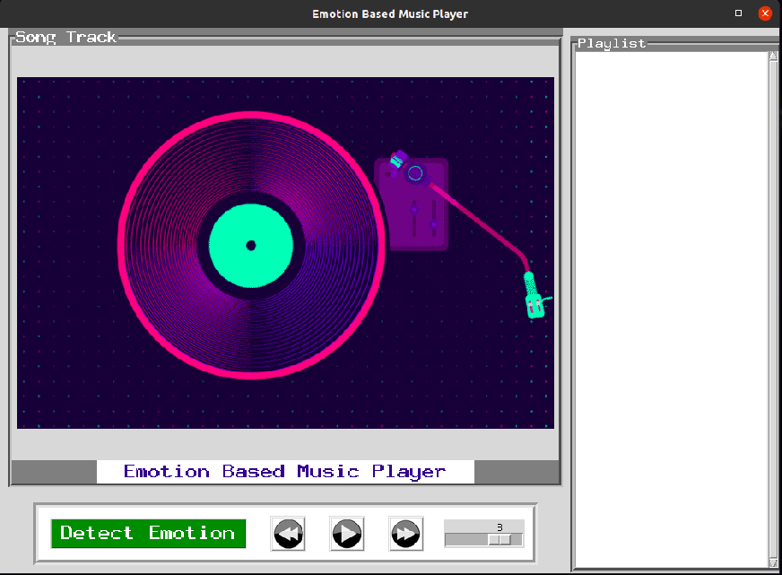
Sample Outputs

Slide 26
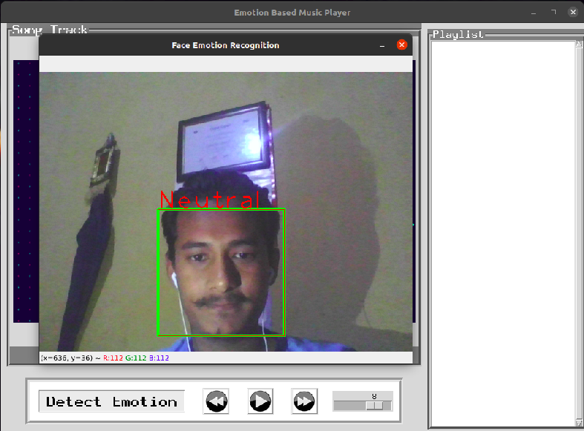
Sample Outputs
Emotion detection

Slide 27
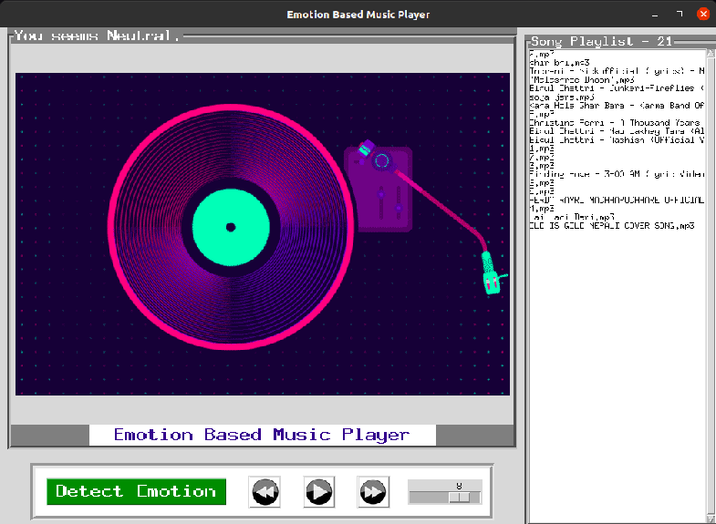
Sample Outputs
Recommended music playlist

Slide 28
Limitations
No login and registration system
System out functions in bad light condition and poor camera resolution
No songs recommendation based on user preferences

Slide 29
Future Enhancement
Endeavour to add a huge number of songs in the future.
Add login and registration system.
Add user's preference.

Slide 30
THANK YOU!!!

Slide 31
QUESTIONS???

